Slide 1
Subject Acceleration
Information for parents and carers 2022

Slide 2
Purpose
Our policy and practices
Our programs are differentiated to cater for the learning needs of all our students
We continuously collect data on student achievement to monitor progress towards course outcomes
Making adjustments to programs to provide additional support in identified areas
Providing extension and enrichment programs to support students with high levels of proficiency in the language, e.g. new arrivals with formal prior learning
Offering acceleration to those students who are intellectually gifted, as well as demonstrating high levels of proficiency in the language

Slide 3
Purpose
Our policy and practices
Our Acceleration Policy is derived from the NSW Department of Education’s High Potential and Gifted Education Policy
https://education.nsw.gov.au/policy-library/policies/pd-2004-0051

Slide 4
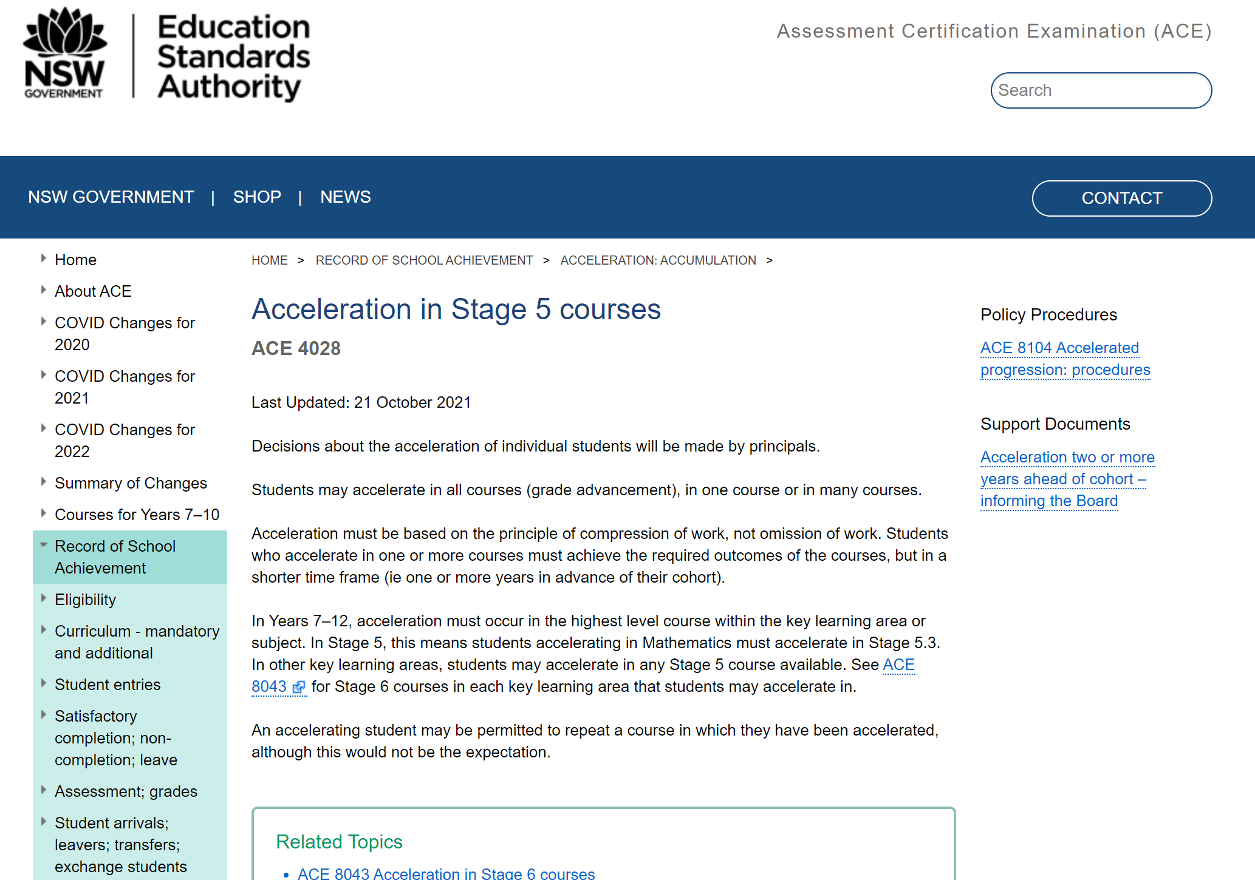
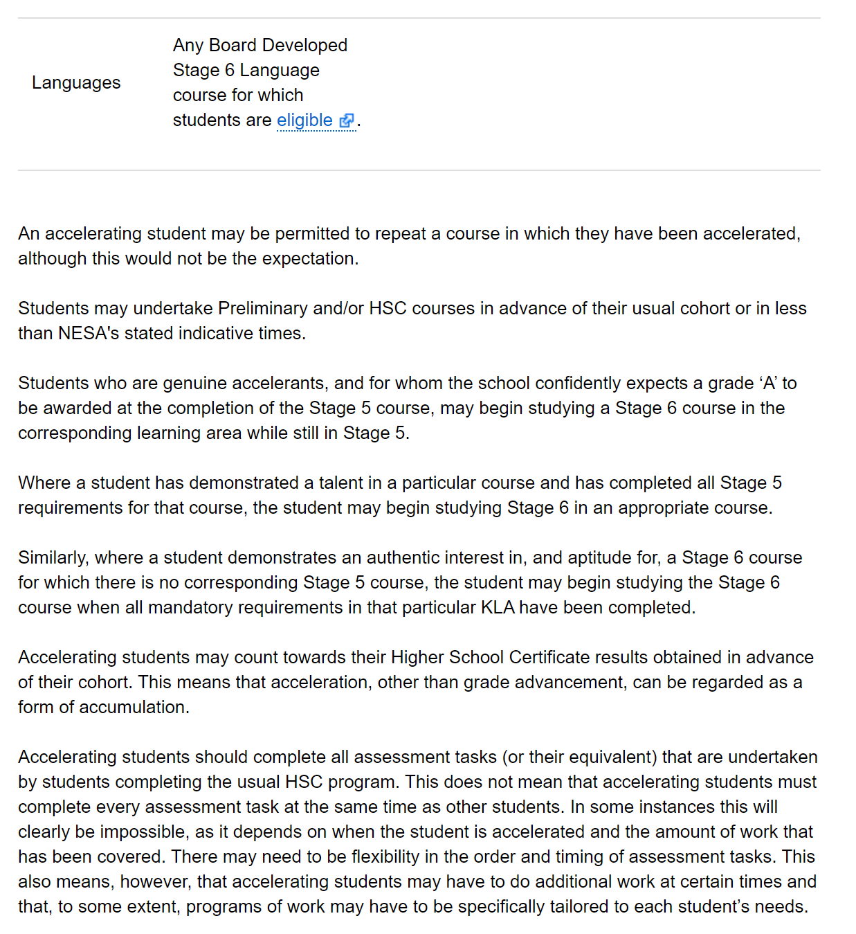
Purpose
Our policy and practices
SCL’s Acceleration Policy meets NESA’ s requirements for students accelerating in Stage 5 and Stage 6
For more information, see NESA’s Assessment, Certification and Examinations Manual, sections 4028, 8043
For students applying to accelerate two years or more ahead of their cohort, the weekday school must inform NESA prior to the acceleration of the student

Slide 5
Acceleration
What is acceleration?
Targets students with high potential and advanced gifts and talents
Involves undertaking a course in advance of the student’s cohort, e.g., a Year 10 student accelerating from the Stage 5 course to study the Preliminary course
Based on a process where students are identified as having high level cognitive function as well as outstanding achievement in their course of study

Slide 6
Characteristics of high potential and gifted students
Attributes of accelerated students in a Language course
Ability to discuss complex ideas and concepts
High-level analytical thinking and problem-solving skills
Quick mastery and recall of factual information
Creativity, curiosity and imagination
Advanced communication skills with high level proficiency in the four skills areas: speaking, listening, reading and writing
High level linguistic knowledge and understanding
Appreciation of the important intercultural role that language plays in communication
Emotional maturity and eagerness to accelerate

Slide 7
Acceleration at the Secondary College of Languages

Slide 8
Learning needs and best interests of the student
When is acceleration advised, and how is it decided?
At the SCL, acceleration is intended mainly for Year 9 students
By the end of Year 9, these students will have achieved all Stage 5 outcomes and will have been identified as high potential and gifted
The decision on whether to accelerate will:
respect the informed views of the parents/carers and the student
be based on reliable, valid and appropriate assessment, to determine whether a student’s learning needs will be best served through acceleration
be made in consultation with the principal and program supervisor at the weekday school
The SCL Principal has the final decision on the acceleration of a student (NESA ACE 4028/ 8043)

Slide 9
Attributes of the accelerating student
display cognitive development, emotional readiness and maturity matched to their linguistic ability
demonstrate exceptional linguistic ability in all four skill areas of speaking, listening, reading and writing. They should not seek acceleration based solely on fluency in a language
be able to engage meaningfully in learning on a Saturday
demonstrate the ability, or the potential ability, for complex thought processes and to engage in learning which involves the analysis of sophisticated concepts and issues, as they may sit for the Preliminary and/or HSC course/s before their cohort
show keen personal interest in and emotional readiness to accelerate

Slide 10
The application process
1. Application
Completed by students and parents/carers and submitted to SCL Principal
2. Evidence
Evidence of student progress and achievement submitted by class teacher
3. Evidence
NAPLAN results and school reports provided by weekday school
4. Assessment
Individual assessment of student performance conducted by class teacher or other expert
5. Interview
Student interviewed by Campus Supervisor to assess emotional readiness to accelerate
6. Approval
Written approval provided by the Campus Supervisor
7. Decision
Final decision provided by the College Principal

Slide 11
What happens after approval has been given
Acceleration will be trialled for ONE term
The student’s Individual Learning Plan will be further developed to include course outcomes, specific learning goals and strategies, a work plan with timeframes and progress checks
Throughout the trial period, acceleration will be monitored, evaluated and adjustments made where necessary to the Individual Learning Plan
At the end of the trial period, a review will be conducted to determine the student’s eligibility to continue in the accelerated course
A review will be conducted again after the yearly examination
The final decision regarding acceleration will be made by the SCL Principal
Note that students will not be permitted to repeat an accelerated course at the SCL

Slide 12
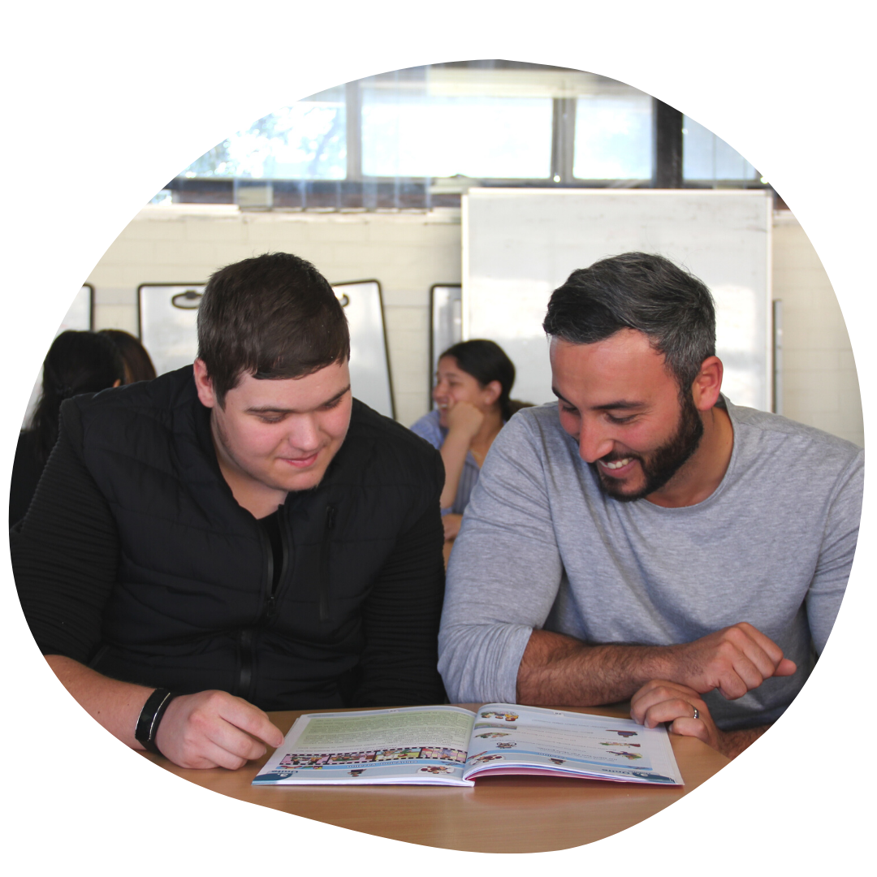
How will accelerated students be supported?
The student’s Individual Learning Plan will be developed and monitored in collaboration with the class teacher
Regular updates will be provided to the Campus Supervisor and Curriculum Coordinator, parents/carers and the weekday school
Other support may include:
A ‘buddy’ from the senior school cohort
A mentor, e.g. a specialist teacher at the weekday school
Contact with external experts, e.g. at tertiary institutions in Australia or overseas

Slide 13
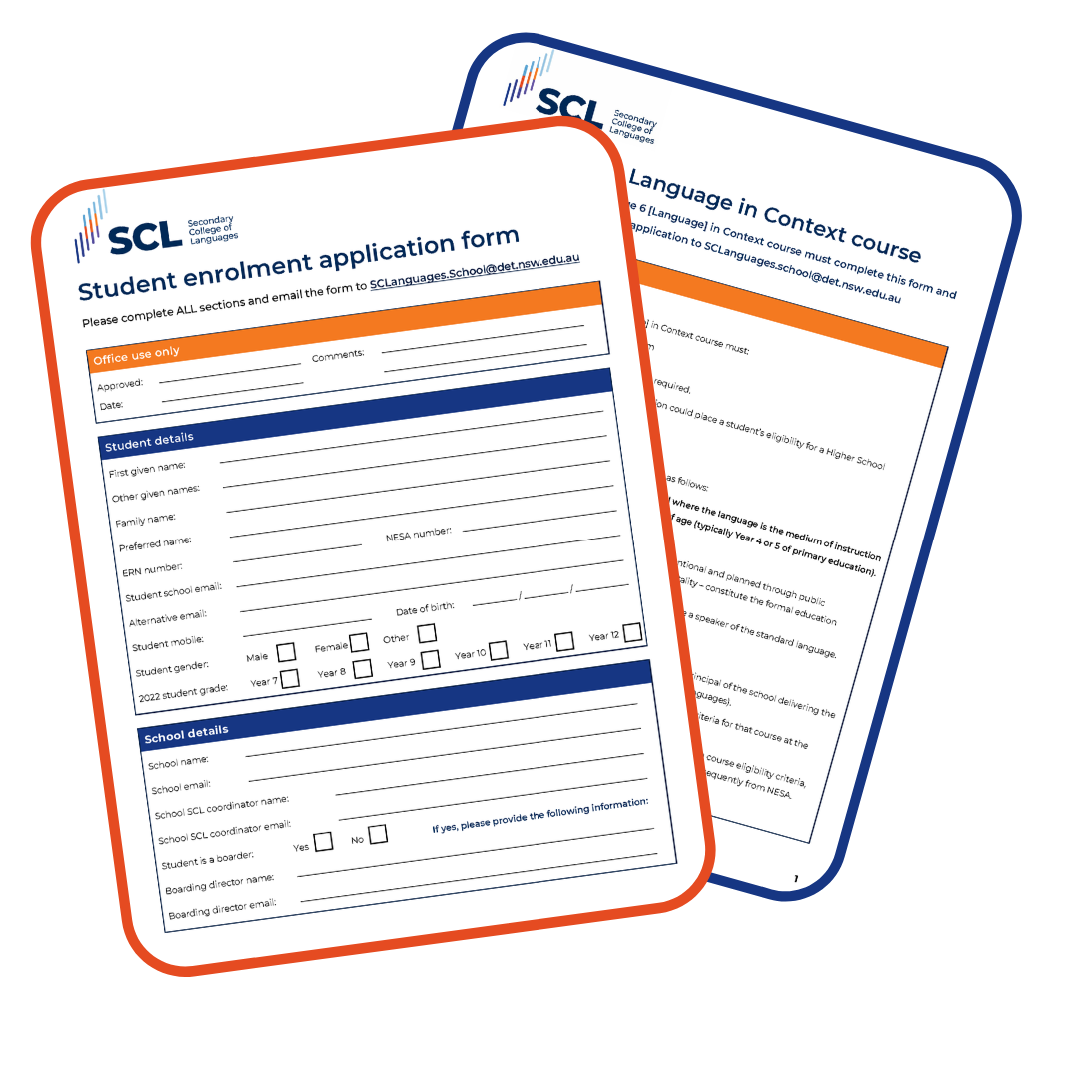
Should you apply for acceleration?
Questions to consider
Has the student demonstrated comprehensive achievement of course outcomes well in advance of the cohort?
Is the student already demonstrating high level of achievement of some outcomes in the next curriculum stage?
Has the student demonstrated high level cognitive function?

Slide 14
Some pros of acceleration
Increased challenge in studying a program that is tailored to your advanced learning needs
Having an opportunity to sit for a Preliminary and/or HSC course earlier than your cohort
Being able to complete your Stage 6 pattern of study over a longer period
Being able to access an Extension Course that you wouldn’t otherwise attempt
Experiencing the HSC climate when attempting only one subject
Understanding how much effort is required to achieve the desired result at HSC level
Gaining greater confidence in the cognitive challenge of Stage 6
Potentially having more units available when calculating ATAR
Having a safety net in case acceleration doesn’t work out

Slide 15
Some cons of acceleration
Concerns about maturity - remaining in the current cohort may result in a stronger performance
Not enough class time over the two years makes more independent learning necessary
Time management, accelerated course documentation and self organisation issues have to be addressed constantly
Anxiety about capacity to succeed in the accelerated course may raise personal stress levels
Gauging the appropriate effort required for HSC Band 6 performance in a non-high stakes year is a challenge
Remaining in the student’s cohort and undertaking an extension and enrichment program may be a better option to ensure maximum results

Slide 16
We are looking for:
Emotional maturity
Capacity
Attainment
Social readiness
Autonomy
Motivation

